Slide 1
Lecture 23: LM3S9B96 Microcontroller - Interrupts

Slide 2
Stellaris® LM3S9B96 Microcontroller
Data Sheet
Chapter 4
Interrupts

Slide 3
ARM Cortex-M3 processor & NVIC
All exceptions are prioritized and handled in Handler Mode
The processor state is automatically stored to the stack on an exception and automatically restored from the stack at the end of the Interrupt Service Routine
The vector is fetched in parallel to the state saving, enabling efficient interrupt entry
Support tail-chaining which enables back-to-back interrupts to be performed without the overhead of state saving and restoration

Slide 4
ARM Cortex-M3 processor & NVIC
Eight priority levels on seven exceptions and 53 interrupts
The highest user-programmable priority (0) is treated as fourth priority, after a Reset, Non-Maskable Interrupt (NMI), and a Hard Fault, in that order.
The default priority is 0 for all the programmable priorities.
If the same priority level is assigned to two or more interrupts, their hardware priority (implementation related) determines the order in which the processor activates them.
The lower position number, the higher priority
For example, if both GPIO Port A and GPIO Port B are priority level 1, then GPIO Port A has higher priority.

Slide 5
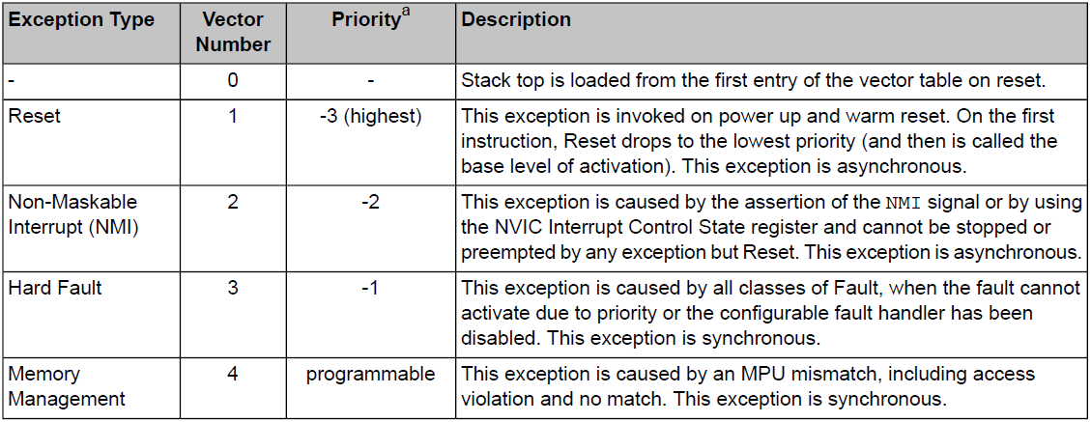
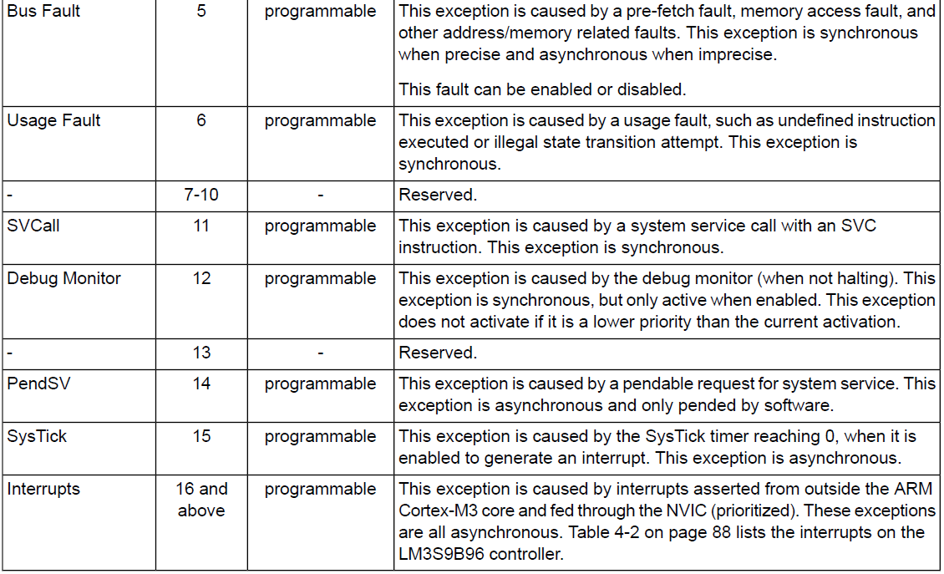
Exceptions

Slide 6
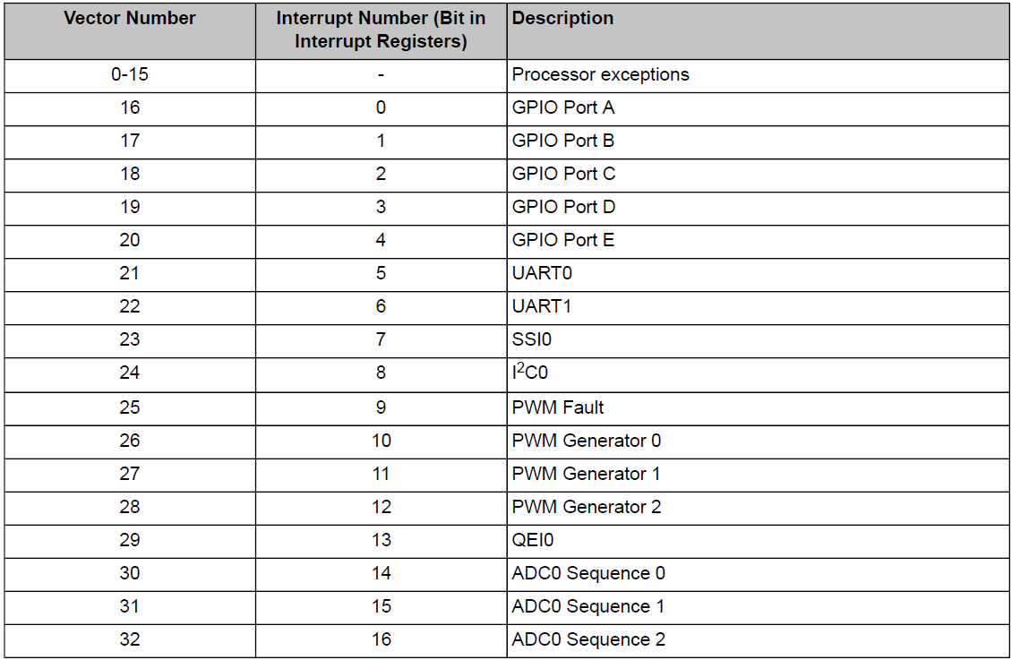
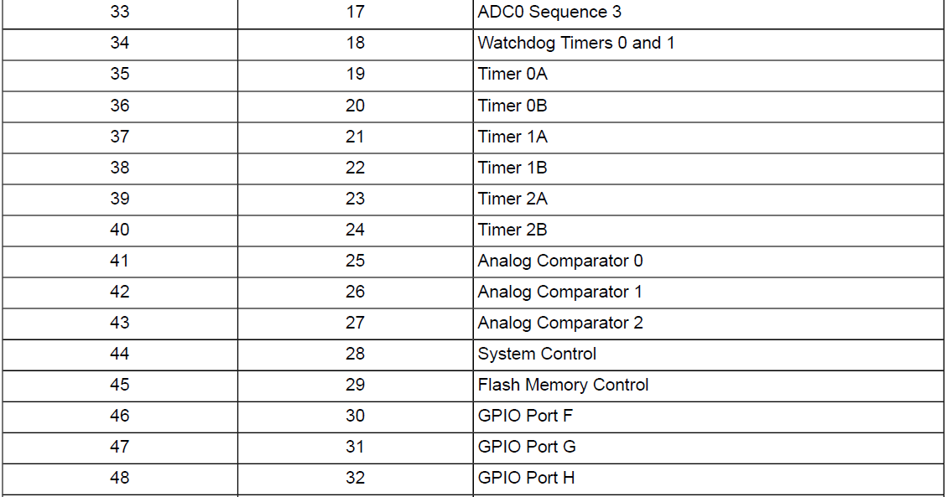
Interrupts

Slide 7
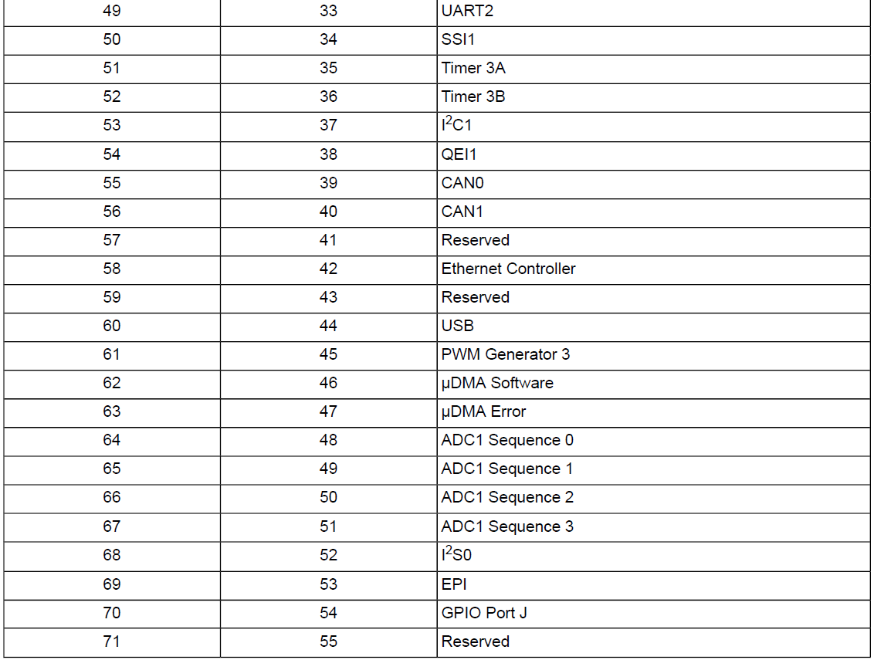
Interrupts

Slide 8
How to configure an Interrupt?
Enable the peripheral (setup the RCGCn)
Configure the interrupt type for the peripheral
Enable the interrupt
Enable the interrupt in the peripheral
Enable the interrupt in the NVIC
Write an interrupt service routine (ISR)
Identify the interrupt source
Clear the interrupt request
Register the ISR in the interrupt vector table

Slide 9
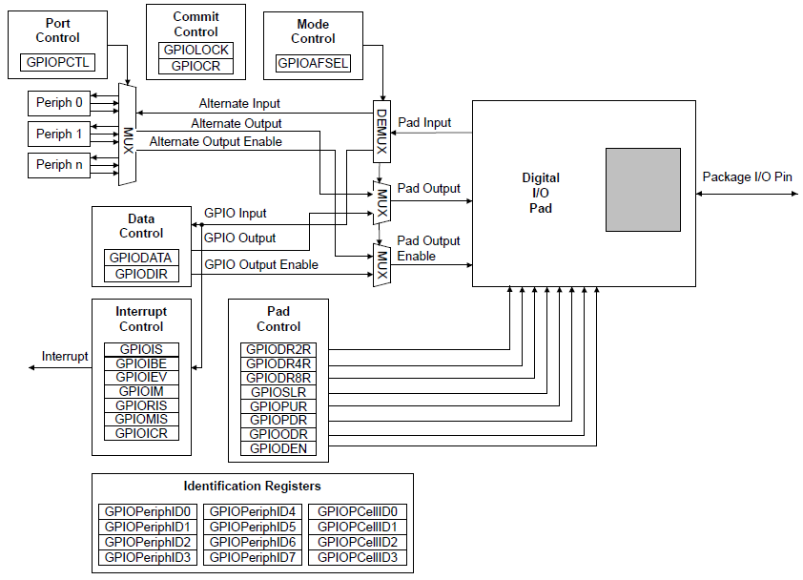
Example: Setting up Interrupt for GPIO

Slide 10
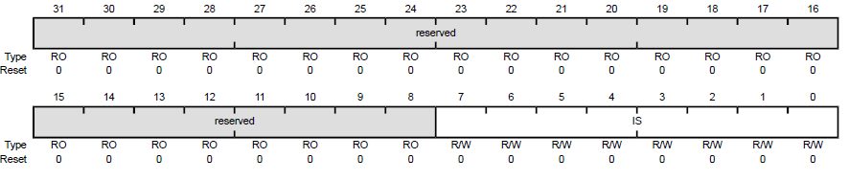
Register Description: GPIOIS
The GPIOIS register is the interrupt sense register
Setting a bit configures the corresponding pin to detect levels
clearing a bit configures the corresponding pin to detect edges
All bits are cleared by a reset

Slide 11
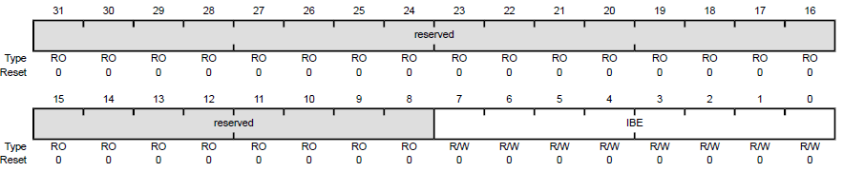
Register Description: GPIOIBE
The GPIOIBE register allows both edges to cause interrupts
Setting a bit configures the corresponding pin to detect both rising and falling edges
clearing a bit configures the pin to be controlled by the GPIOIEV register
All bits are cleared by a reset

Slide 12
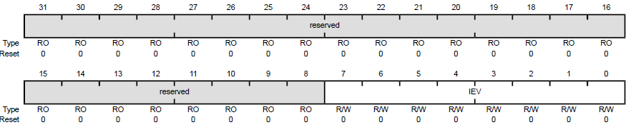
Register Description: GPIOIEV
The GPIOIEV register is the interrupt event register
Setting a bit configures the corresponding pin to detect rising edges or high levels
clearing a bit configures the pin to detect falling edges or low levels
All bits are cleared by a reset

Slide 13
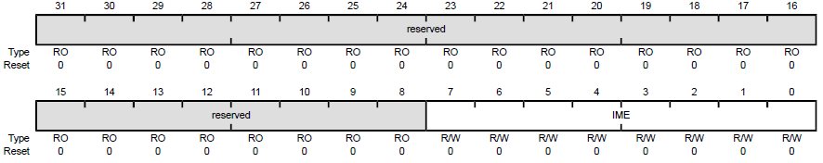
Register Description: GPIOIM
The GPIOIM register is the interrupt mask register
Setting a bit allows interrupts that are generated by the corresponding pin to be sent to the interrupt controller on the combined interrupt signal
Clearing a bit prevents an interrupt on the corresponding pin from being sent to the interrupt controller
All bits are cleared by a reset

Slide 14
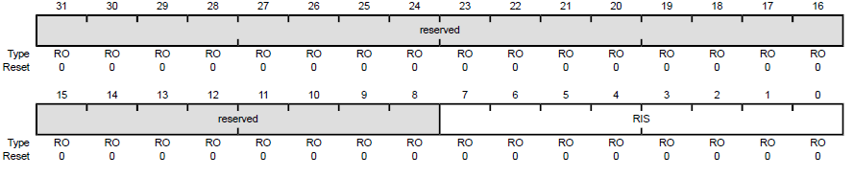
Register Description: GPIORIS
The GPIORIS register is the raw interrupt status register
A bit in this register is set when an interrupt condition occurs on the corresponding GPIO pin
A bit in this register can be cleared by writing a 1 to the corresponding bit in the GPIO Interrupt Clear (GPIOICR) register

Slide 15
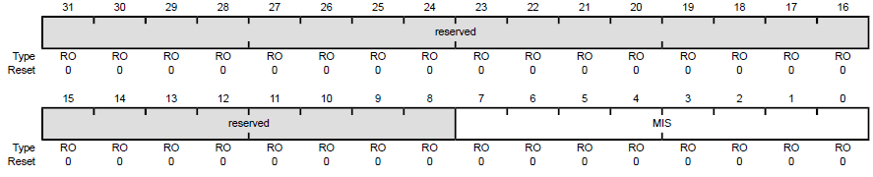
Register Description: GPIOMIS
The GPIOMIS register is the masked interrupt status register
A bit in this register is set when the corresponding interrupt has triggered an interrupt to the interrupt controller
If a bit is clear, either no interrupt has been generated, or the interrupt is masked

Slide 16
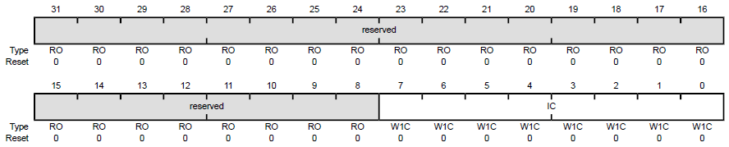
Register Description: GPIOICR
The GPIOICR register is the interrupt clear register
Writing a 1 to a bit in this register clears the corresponding interrupt bit in the GPIORIS and GPIOMIS registers

Slide 17
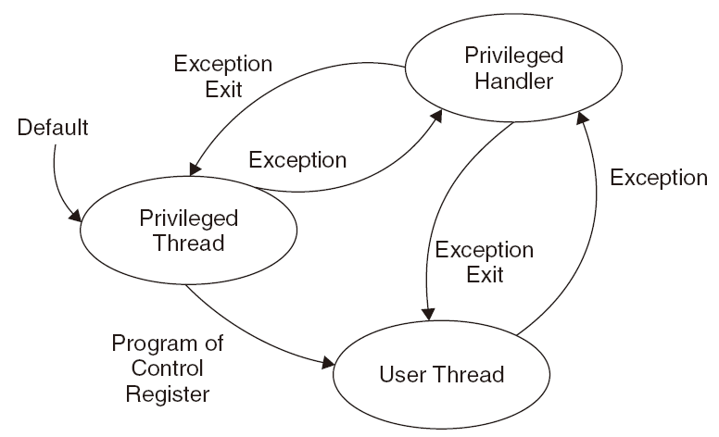
Setting up NVIC
The LM3S9B96 microcontroller supports 53 interrupts with eight priority levels
The NVIC maintains knowledge of the stacked (nested) interrupts to enable tail-chaining of interrupts
You can only fully access the NVIC from privileged mode

Slide 18
Setting up NVIC
1. Set up the priority group register (group 0 by default).
2. Setup the hard fault and NMI handlers to a new vector table location if vector table relocation is required.
3. Set up the Vector Table Offset register if needed.
4. Set up the interrupt vector for the interrupt：[read the Vector Table Offset register and] calculate the correct memory location for the interrupt handler.
5. Set up the priority level for the interrupt.
6. Enable the interrupt.

Slide 19
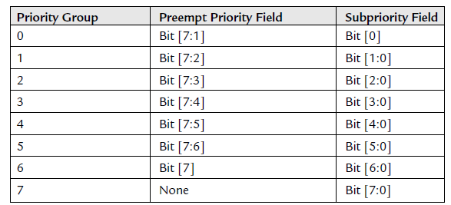
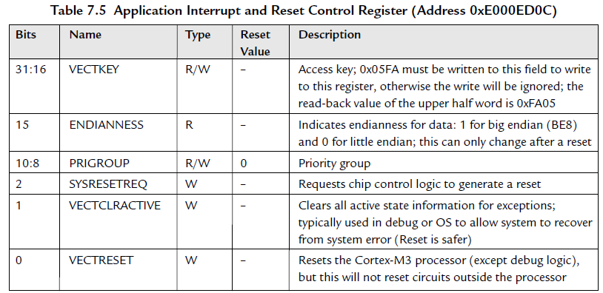
Setup the Priority Group
;Application Interrupt and Reset Control Register
LDR R0, =0xE000ED0C
; Priority Group 5 (2/6)
LDR R1, =0x05FA0500
; Set Priority Group
STR R1, [R0]

Slide 20
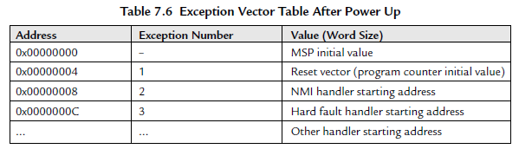
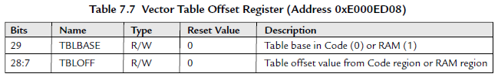
Setup the Interrupt Vector
; Get starting address of IRQ#7 handler
LDR R0, =IRQ7_Handler
; Vector Table Offset Register
LDR R1, =0xE000ED08
LDR R1, [R1]
; Calculate IRQ#7 handler vector address
ADD R1, R1, #(4*(7+16))
; Setup vector for IRQ#7
STR R0, [R1]

Slide 21
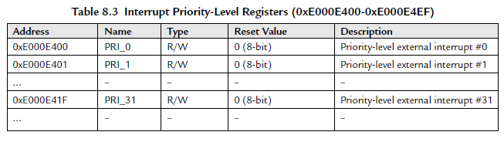
Setup the Interrupt Priority
; External IRQ priority base
LDR R0, =0xE000E400
; Set IRQ#7 priority to 0xC0
MOV R1, #0xC0
STRB R1, [R0,#7]

Slide 22
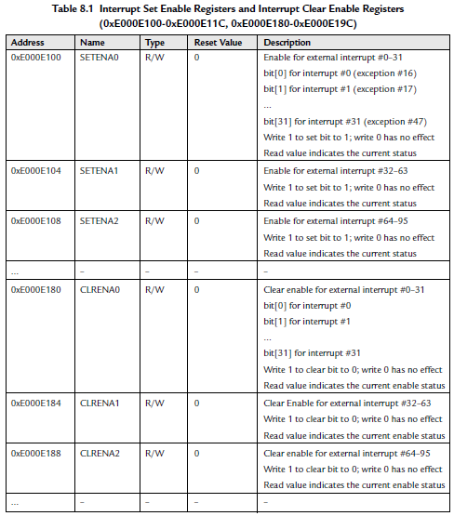
Enable the interrupt
; SETEN register
LDR R0, =0xE000E100
; IRQ#7 enable bit (value 0x1 shifted by 7 bits)
MOV R1, #(1<<7)
; Enable the interrupt
STR R1, [R0]

